Slide 1
Westview Community Drainage Study
Thursday, August 31, 2023

Slide 2
Agenda
Welcome & Introductions
Model Overview & Results
Key Takeaways
Q&A

Slide 3
Welcome and Introductions
City Staff – Joi Crawley
FWR Staff – Charles Crowell
Scope Overview – Joi/Charles

Slide 4
Model Overview
Flooding is a chronic issue in the Westview neighborhood that stems from aging and undersized infrastructure
The model was created to:
Identify the causes of neighborhood flooding
Pinpoint issues that have been difficult to confirm visually
Integrate a wealth of data into a single document
Test the efficacy of solutions to address each flooded location’s cause for flooding
Notes:
Data Integrated into the Model
Historical survey
New survey collected for this project
As-built data from sewer separation
City of Atlanta Storm Drain Inventory
CCTV inspection videos
Survey and LiDAR topology
Neighborhood flooding records
Flow monitoring data

Slide 5
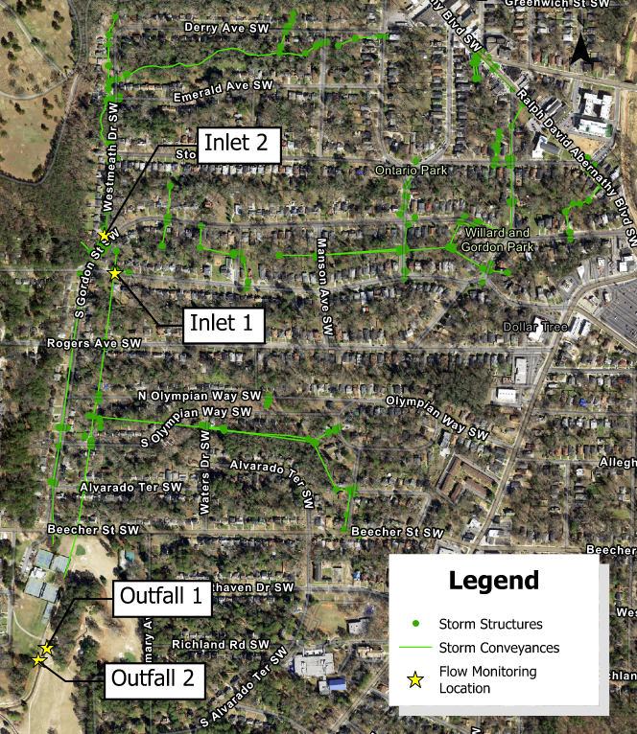
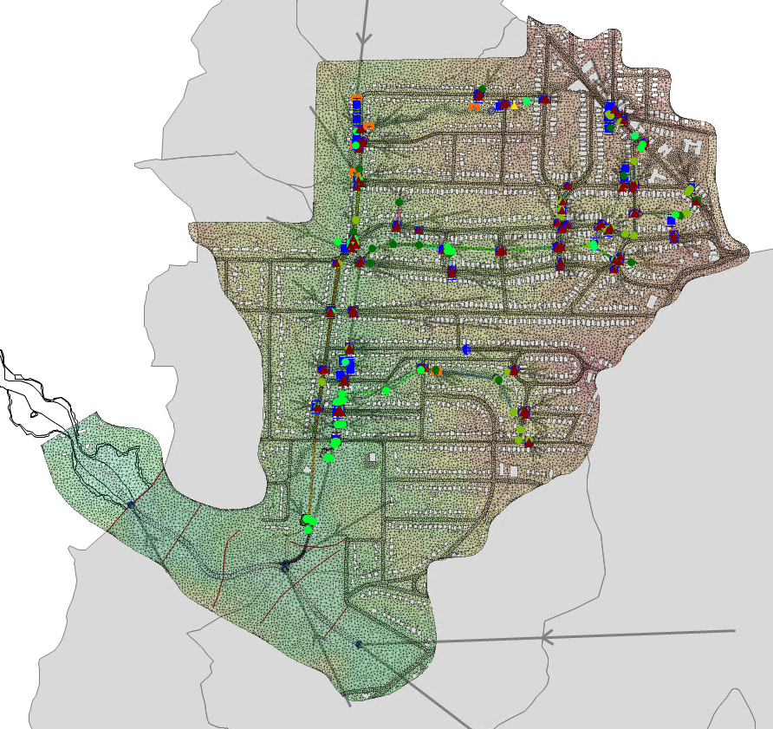
Model Overview

Slide 6
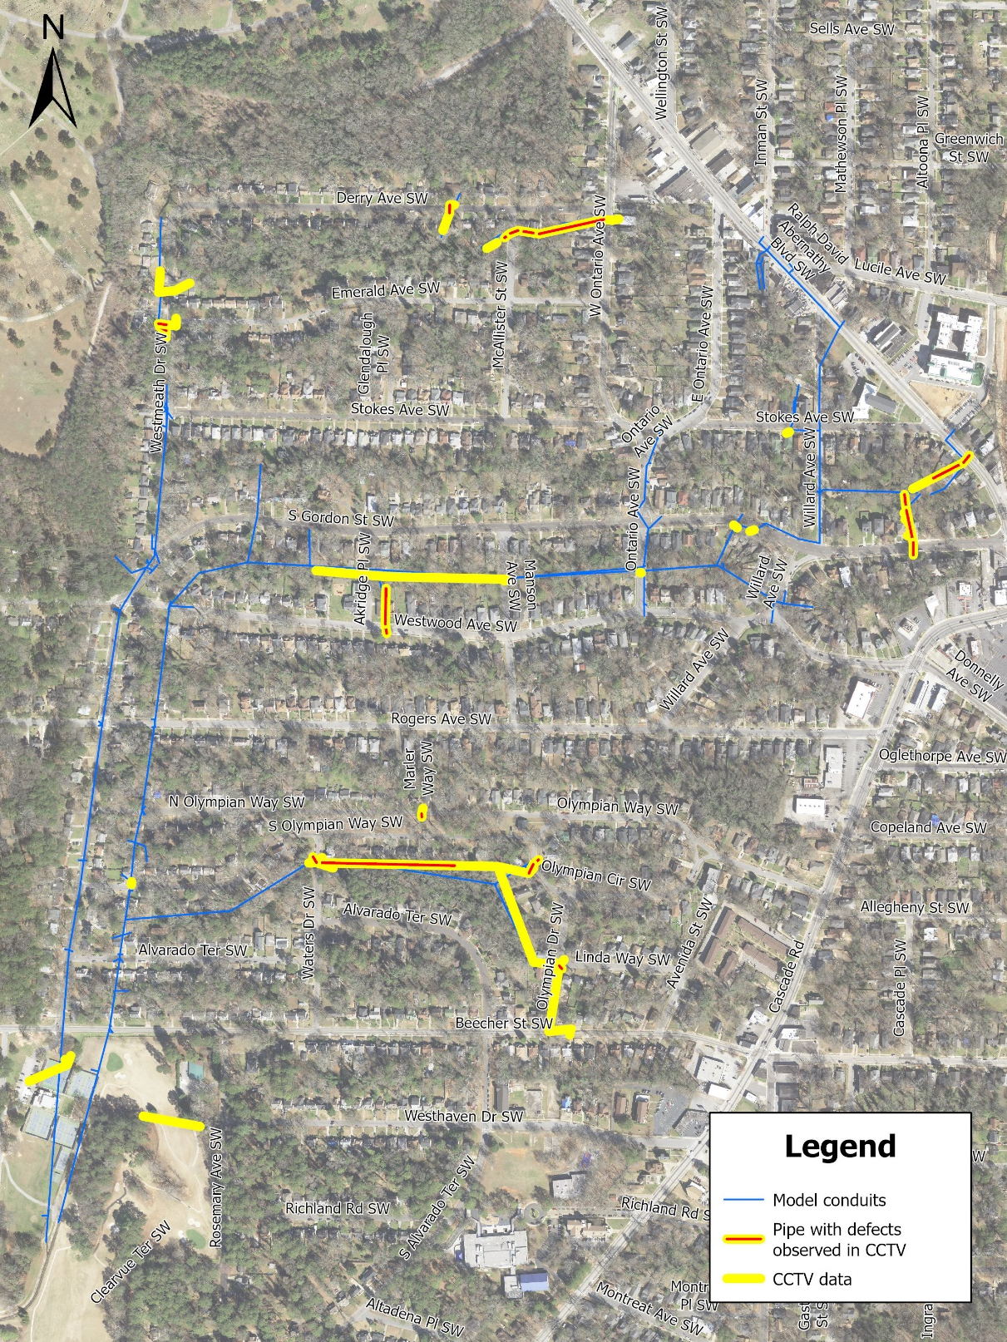
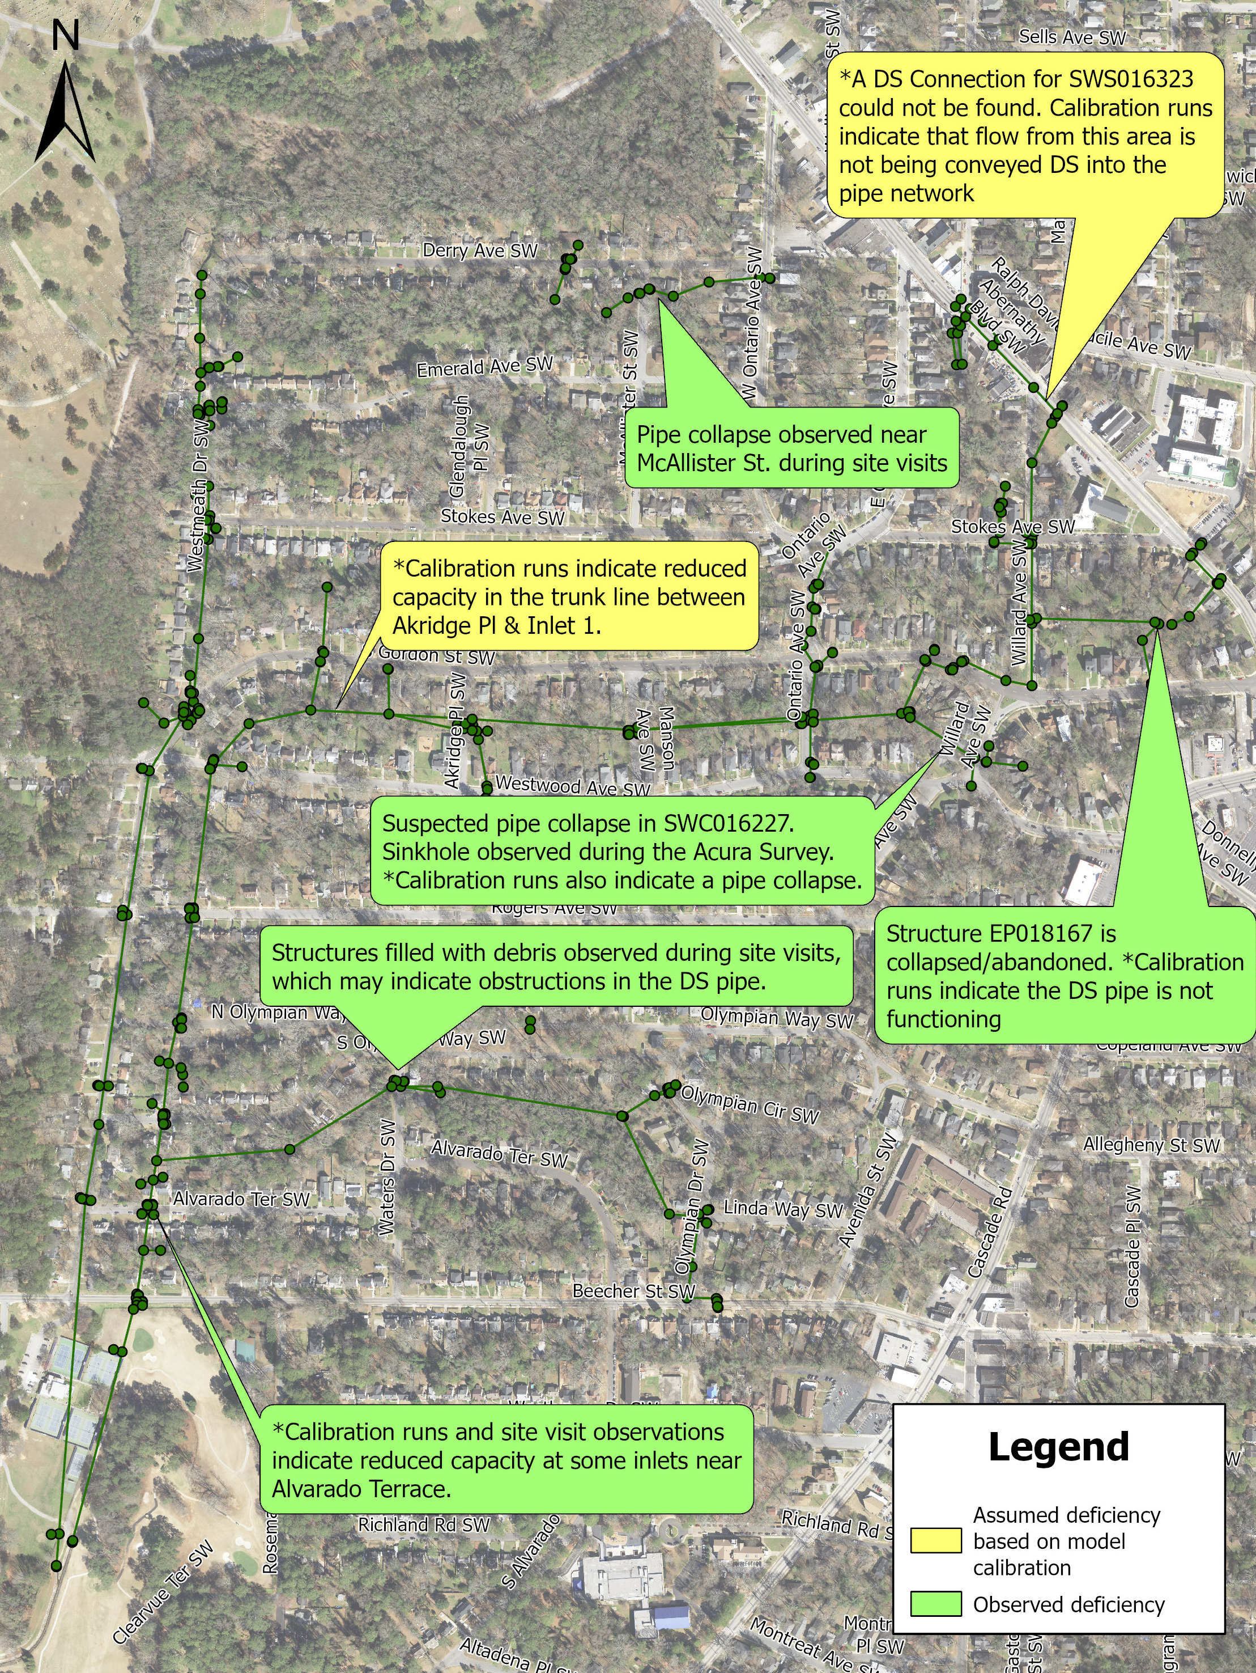
Model Data Integration
CCTV DEFECT LOCATIONS
CONFIRMED AND ASSUMED DEFECT LOCATIONS
Many parts of the system could not be observed with CCTV due to inaccessible structures or obstructed pipes.
A portion of the collected CCTV data could not be used due to inconsistencies between naming conventions of the CCTV data and previous surveys.

Slide 7
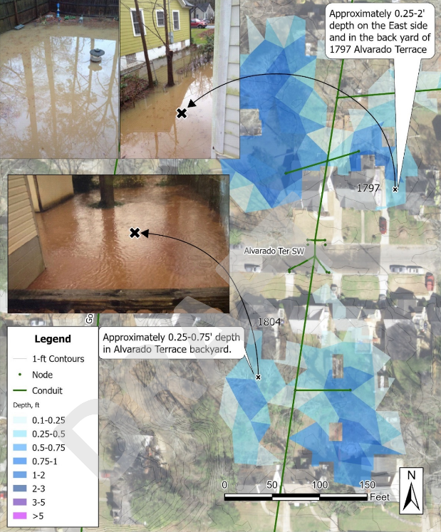
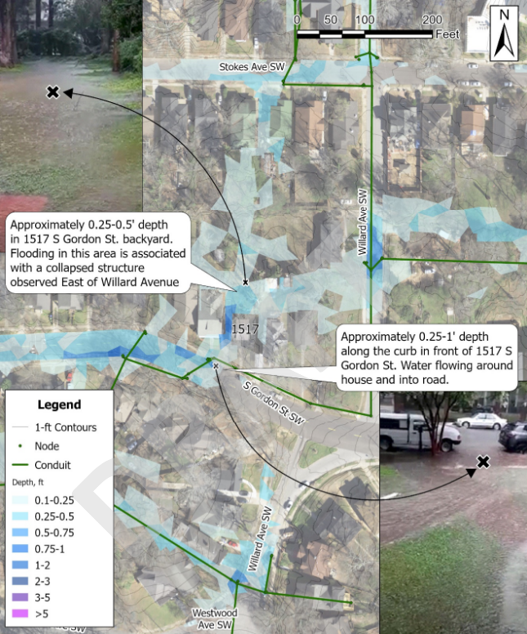
Model Validation and Calibration

Slide 8
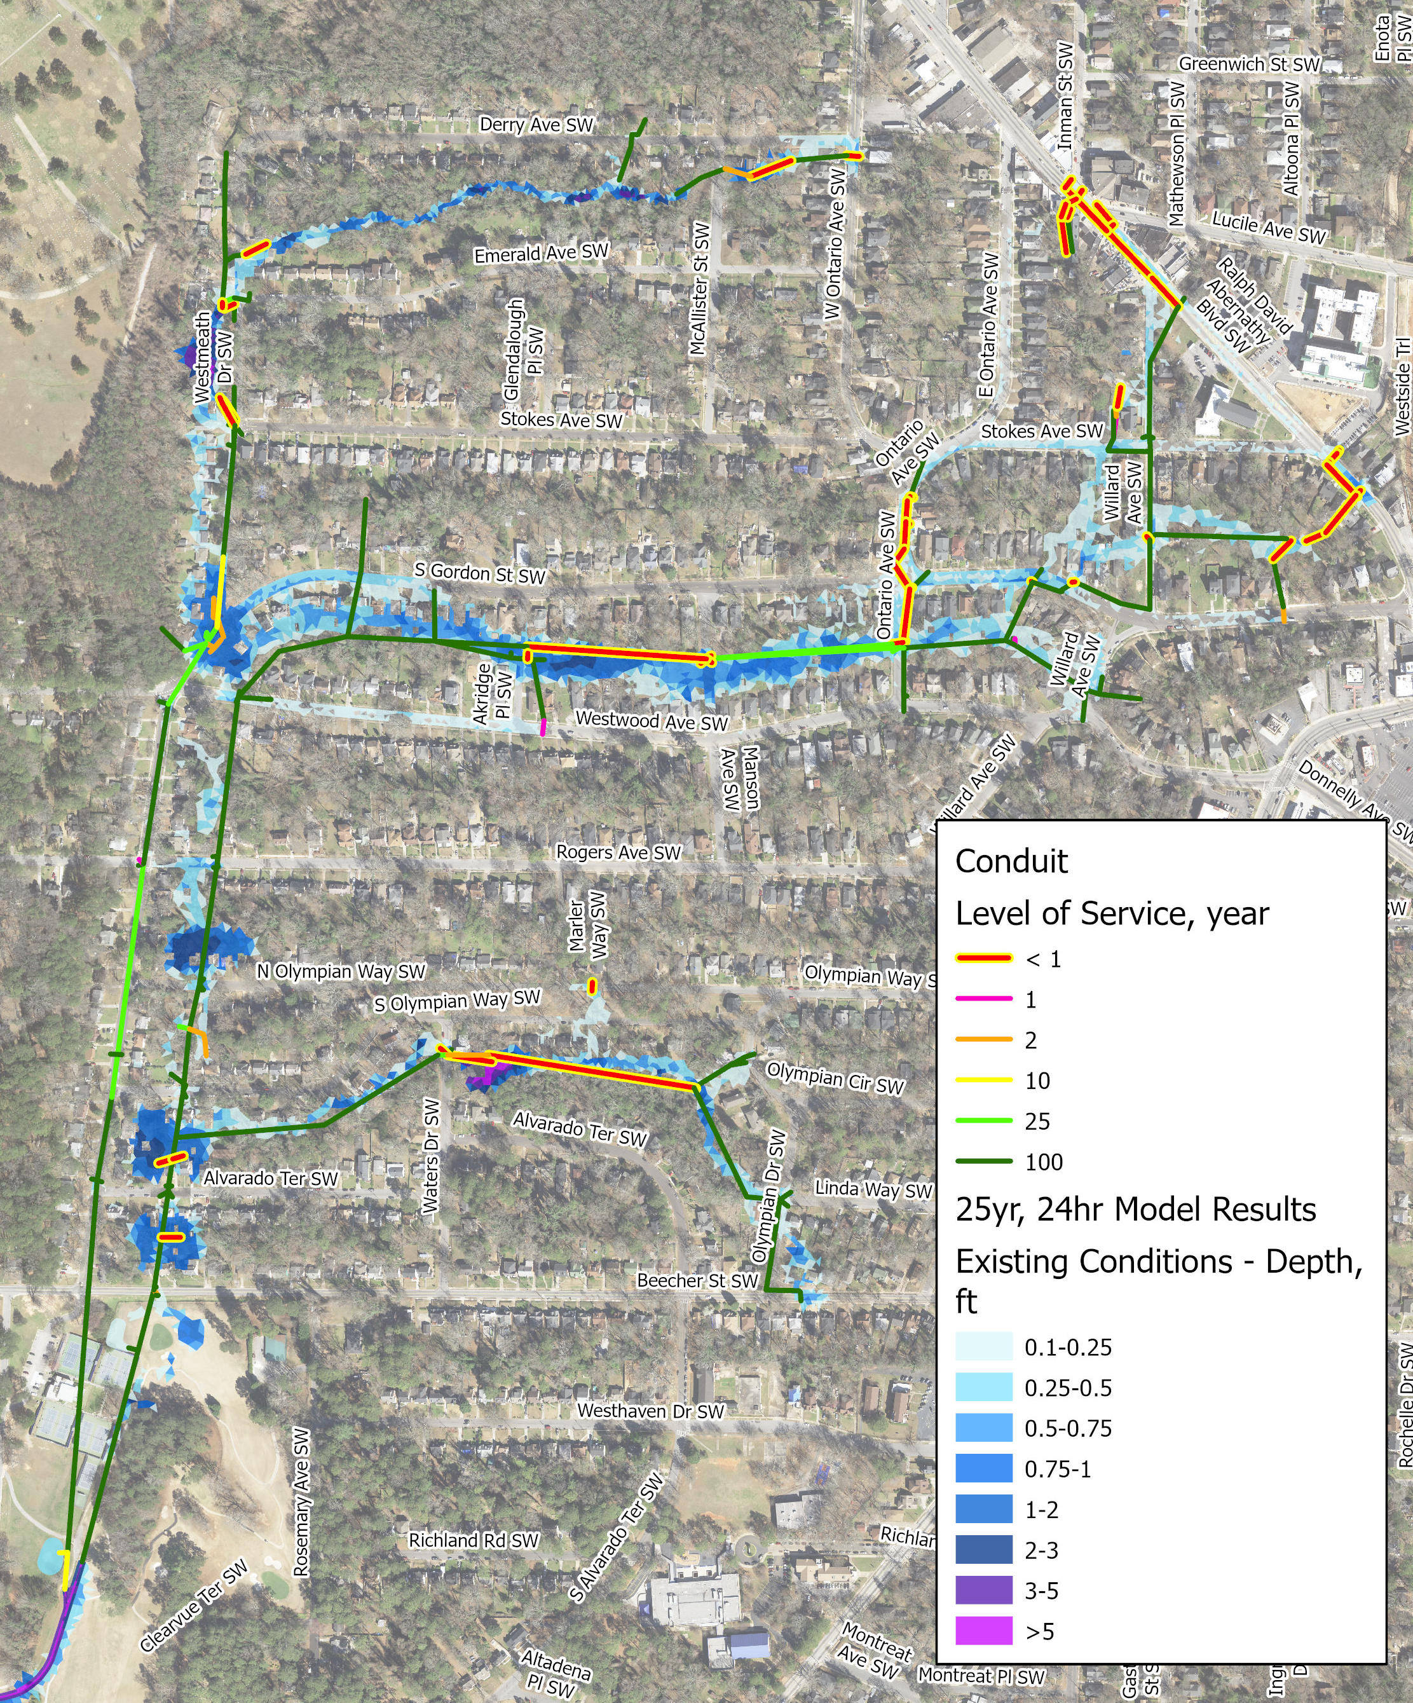
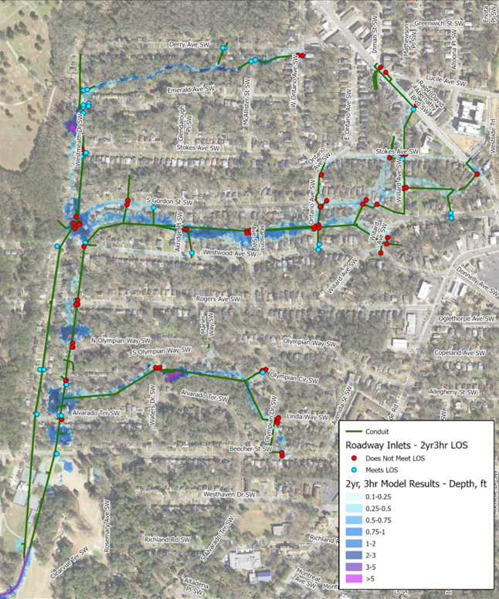
Model Level of Service Analysis
PIPE LEVEL OF SERVICE
STRUCTURE LEVEL OF SERVICE

Slide 9
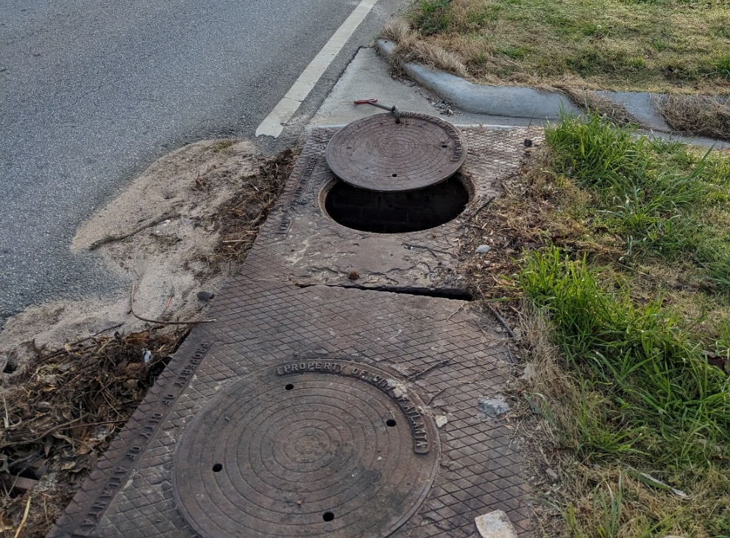
Model Summary
Flooding is caused by:
Service life of pipes has expired, approaching 100-years
Undersized storm sewer infrastructure for current City Regulations
Steep watershed
High percentage of impervious coverage
Not enough inlets
Problems observed:
Reduced roadway inlet capacity due to over-paving and clogging
Defects in pipes and structures that reduce system capacity
Numerous issues located in historic alleys

Slide 10
Key Takeaways
The model helped identify defects that could not be visually located during previous data collection and modeling efforts
Can determine the magnitude of the defect
The model is a new tool to test various concept solutions to determine the most effective solution or suite of solutions
The model has been validated with photos and flow monitoring data which provides confidence that any solutions will be holistic and will not shift the problem somewhere else

Slide 11
Path Forward
Phase I – Complete modeling to determine necessary upsizing and locations of structures – Summer 2023.
Phase II – Prioritization of projects – Fall 2023.
Construction – Spring 2024 may utilize existing contractor to expedite process.
Continue to complete proactive maintenance to keep existing structures clear of debris.
Actively monitor location during wet weather conditions and address ponding/flooding observed.

Slide 12
Questions or Concerns?
page 12

Slide 13
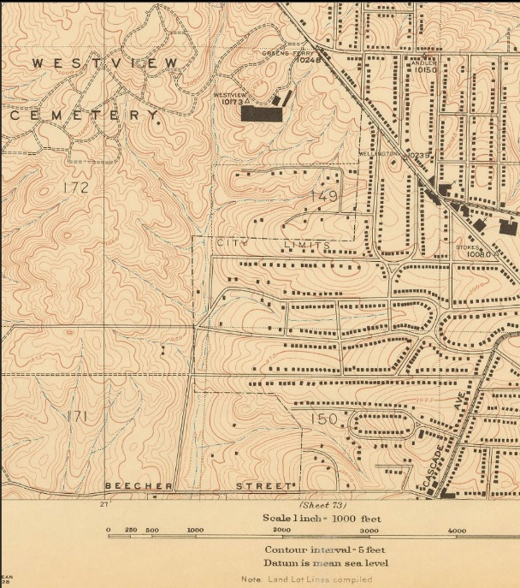
Historical Blue Lines

Slide 14
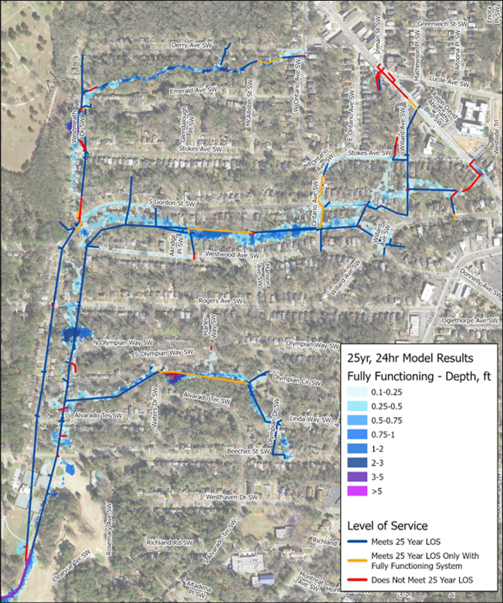
Model Fully Functioning LOS
PIPE LEVEL OF SERVICE – FULLY FUNCTIONING

