Slide 1
Brawley Drive Pedestrian Walkway & Greenspace Project Grant Final Report
Governmental and Political Consultants, Inc.

Slide 2
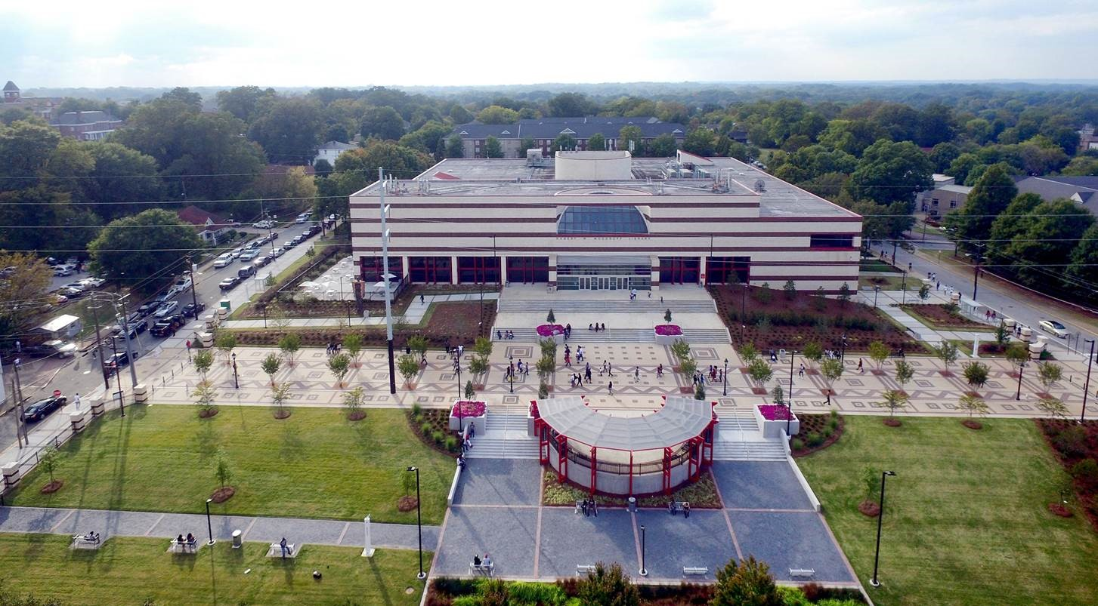
Brawley Drive Pedestrian Walkway and Greenspace
Notes:
(Picture of JPB Walkway)
Completion of this project has yielded an attractive and environmentally sustainable design for a safe, aesthetically appealing pedestrian boulevard and campus greenspace for Atlanta University Center students and stakeholders.

Slide 3
Agenda
Introductions
Detailed Summary
Project background overview
Objectives
Project Conditions Met
Financials
Closing Remarks
Presentation Update
JP Brawley Greenspace & Pedestrian Walkway
University Community Development Corp. Board Presentation

Slide 4
Project Background & Overview

Slide 5
Project Background & Overview
The block of James P. Brawley Avenue between Parsons and Beckwith streets abandoned by the City and now owned by the Library remains closed to traffic and has become an extension of the pedestrian mall that connects the campuses of the Atlanta University Center. The existing asphalt and traffic barriers were replaced, and the pavement and dated street lighting replaced. This Brawley Drive Pedestrian Walkway and Greenscape project has extended the spaces for student learning, collegiate gatherings, and it completes the land development work begun ten years ago. The improved area now provides an attractive campus gathering spot and an outdoor space to support curriculum and library instruction and programs. Landscape improvements included sustainable design features such as native vegetation, permeable paving surfaces, and a rainwater capture system for site irrigation. The area has improved patron safety with the installation and expansion of security features, i.e. fencing, lighting, call boxes, and security cameras. In addition, the southern and northern side yards of the library received a refreshed landscape design.
Notes:
There’s a rainwater reservoir that runs under Clark’s campus

Slide 6
The block of James P. Brawley Avenue between Parsons and Beckwith streets, abandoned by the City, is now owned by the Library. Streets are now closed to vehicular traffic and James P. Brawley is an extension of the pedestrian mall that connects the campuses of the Atlanta University Center: beginning at Spelman’s backgate the walkway spans beyond the CAU classroom to the entrance of the Robert W. Library. The existing asphalt and traffic barriers were removed, and pavement replaced with new pavers and improved street lighting. This Brawley Drive Pedestrian Walkway and Greenscape project has extended the spaces for student learning, collegiate gatherings, and it completes the land development work that begun ten years ago.

Slide 7
Project Objectives
Notes:
Silverman Construction Program Management, Inc.

Slide 8
Objectives
Visual improvement to the physical street and lot adjacent to the library with expected increase in land value
A safe outdoor feature linking student interaction with nature and learning
Enhancement of the library’s entry experience and creation of a venue for informal student interactions and a place to meet and greet
Space to accommodate small scale events for teaching and learning with designed durability for low maintenance

Slide 9
Conditions Met

Slide 10
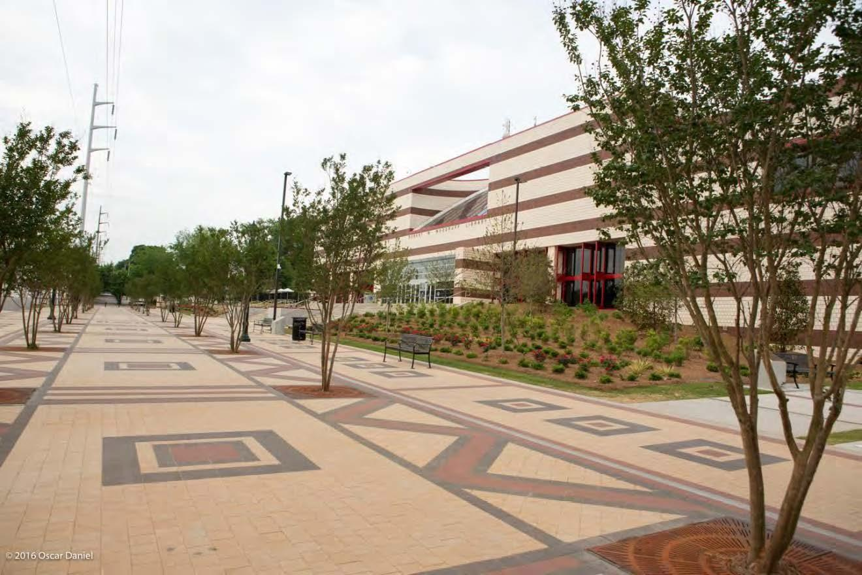
The project extended the Brawley corridor paving, connecting the rest of the AUC community to the library. This block is an important link to a future pedestrian corridor connection to Martin Luther King Drive.

Slide 11
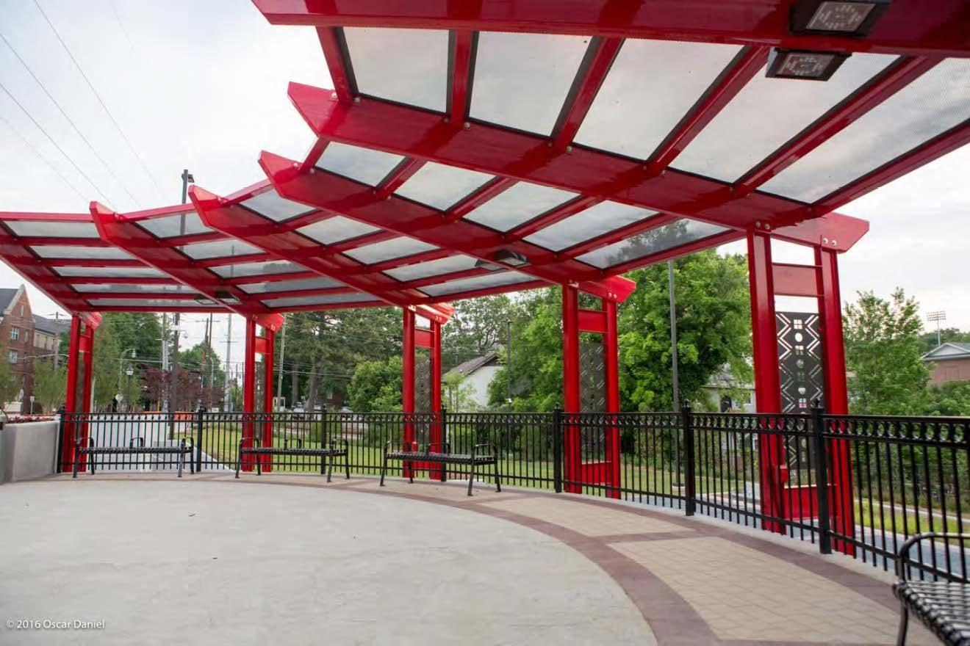
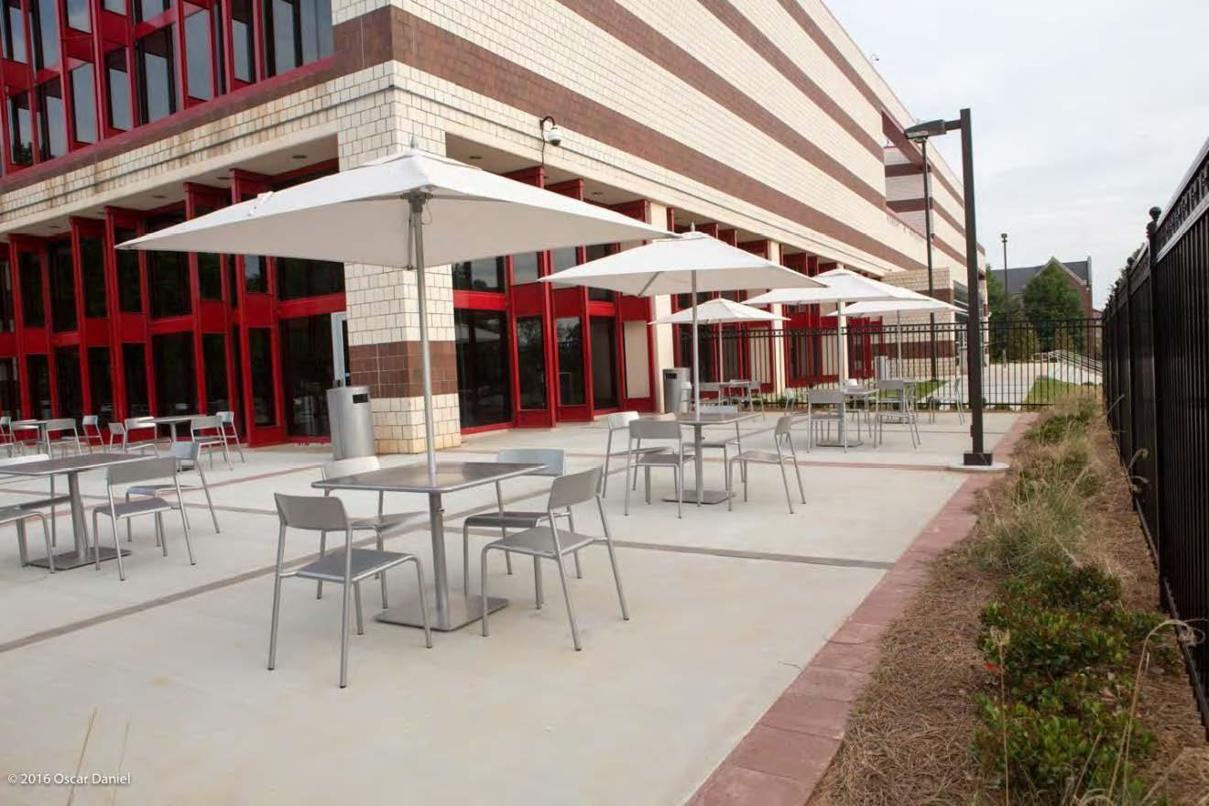
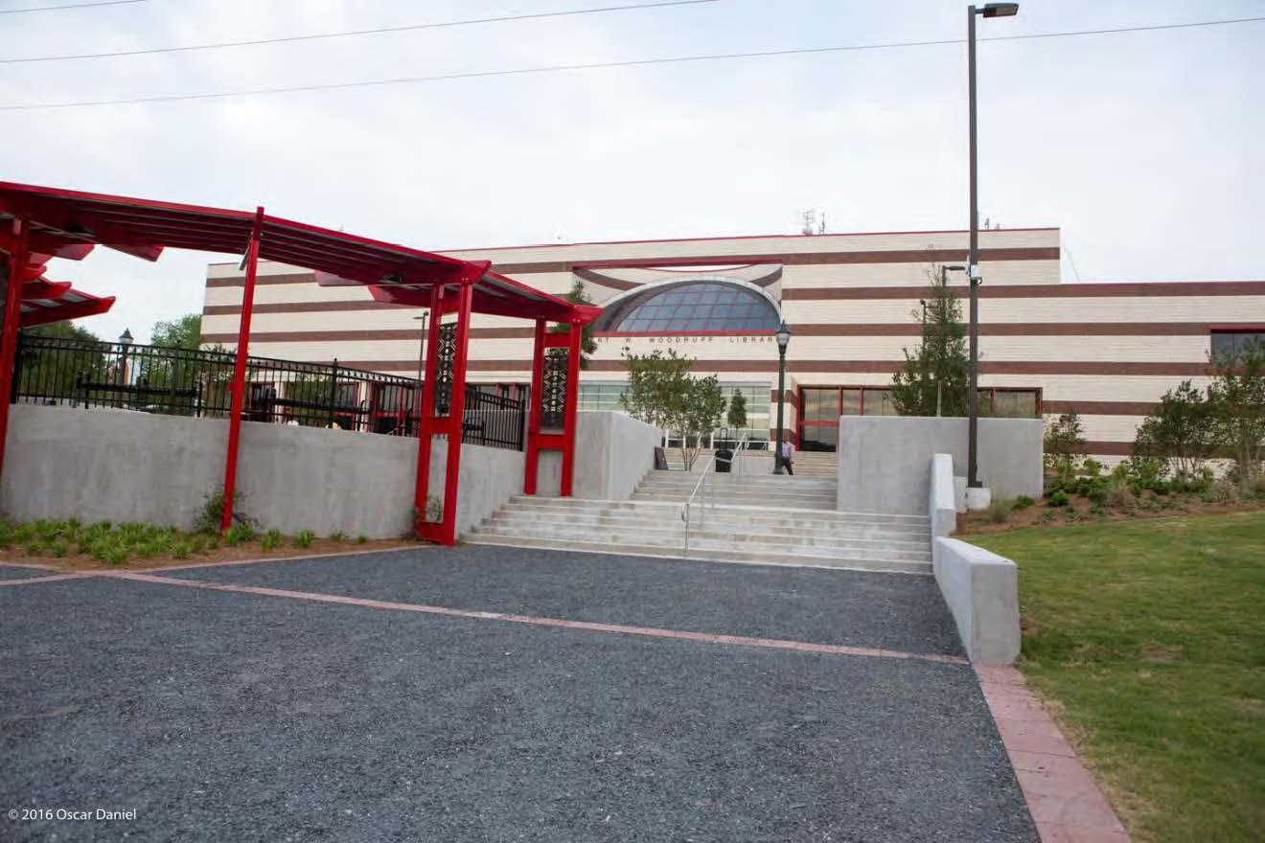
The new space features central overlook and performance space, a lower garden plaza for small group gathering, and a dining patio for faculty and students
Notes:
Creation of ADA access via a side door and not just the front entry.

Slide 12
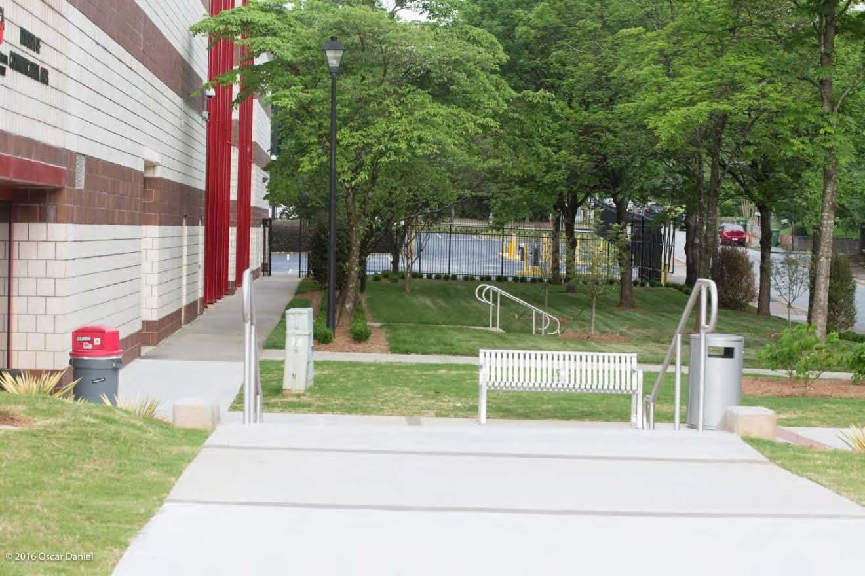
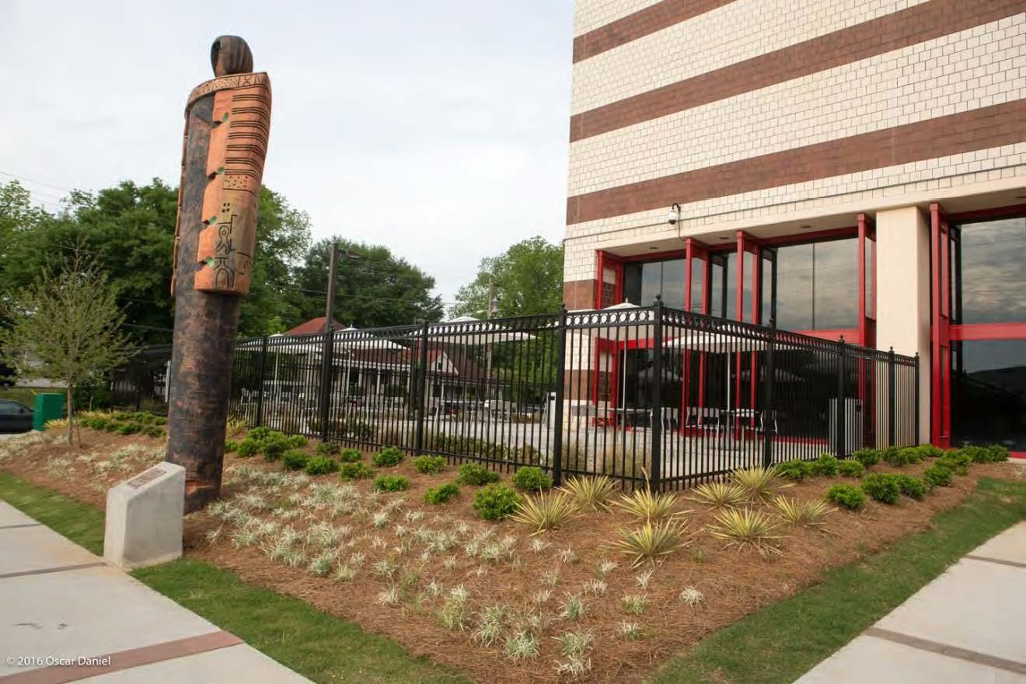
New landscaping is both functional and aesthetic.
Plant materials were selected to maximize year round interest with minimal maintenance
Evergreen species have been placed to provide adequate screening from adjacent properties
A new irrigation system which takes advantage of technology will help reduce water usage and maintenance issues while keeping the new landscape healthy and vibrant

Slide 13
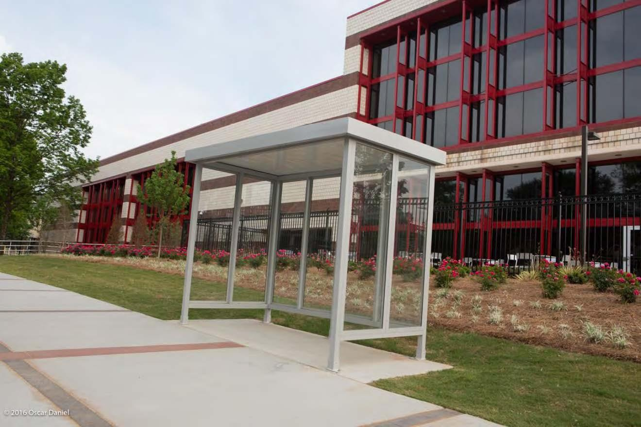
Installation of much improved identification signage for walkers and vehicles traveling Beckwith and Parsons Street

Slide 14
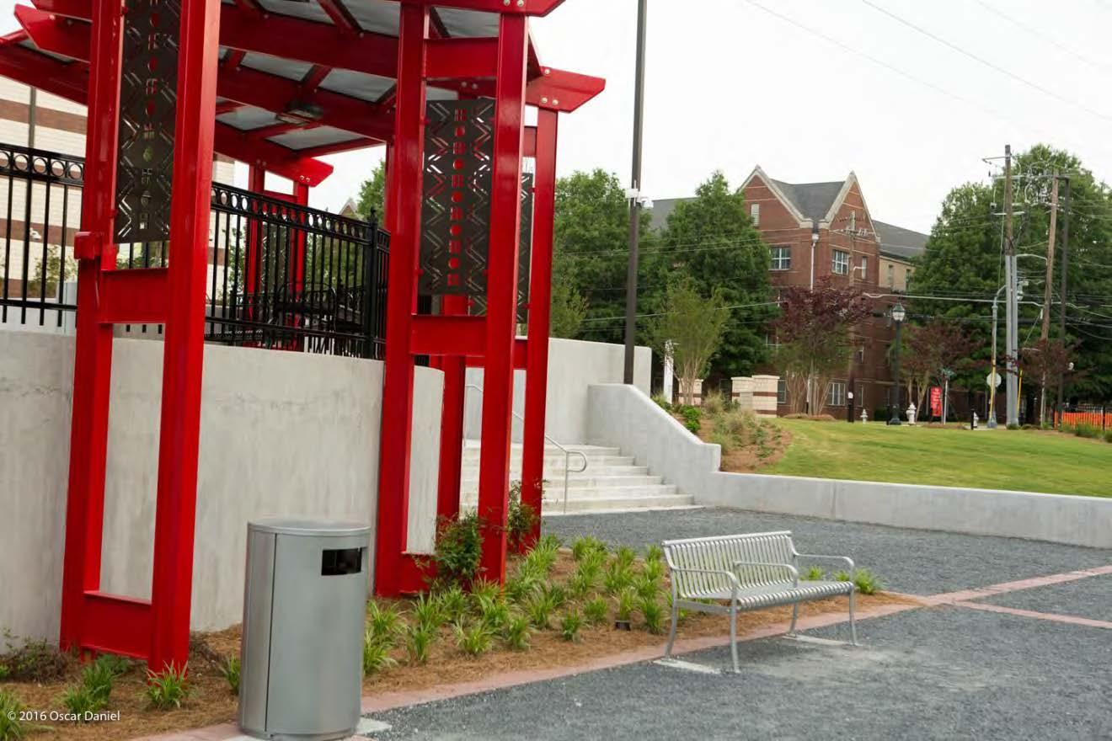
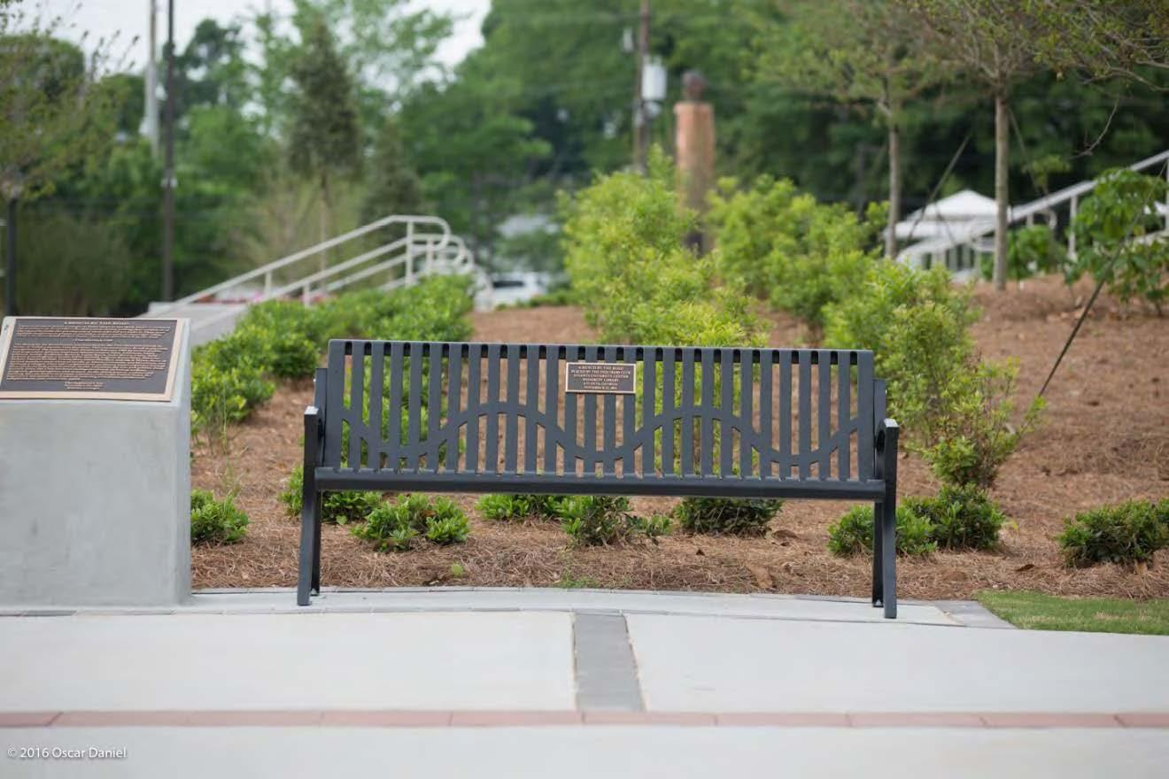
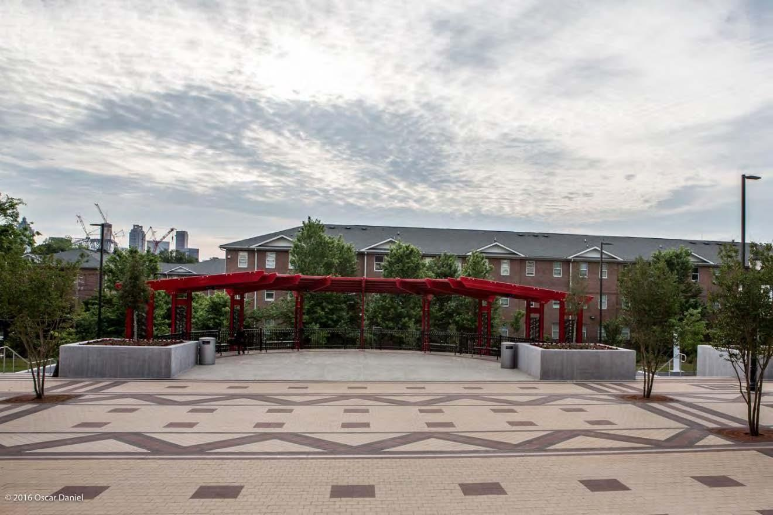

Slide 15
Brawley Drive Pedestrian Walkway and Greenspace
Notes:
(Picture of JPB Walkway)
Completion of this project has yielded an attractive and environmentally sustainable design for a safe, aesthetically appealing pedestrian boulevard and campus greenspace for Atlanta University Center students and stakeholders.

Slide 16
Project Features
Underground retention pond collects rain and runoff water and carries excess water to the sewer and a rain garden found in the lower garden
Drainage pipe found on the roof was connected to new retention pond
All lighting was replaced with LED lighting
Widened the front steps and added an handicap access ramp; the steps, access ramp, and surrounding walkway access was rebuilt with granite
Existing statue built during the 1996 Olympics remained in the same location
Added outdoor seating with tables and overhead covering located just exterior of the new Woodi Cafe
Vehicle blockades are removable to allow for vendors or performances
Cluttered power and transmissions lines were ran underground; planted trees complying with Georgia Power regulations
Vocal plans to further extend the pedestrian walkway to Martin Luther King Jr. Drive are still in the works

Slide 17
Project Funding Resources
Notes:
Exec Slide

Slide 18
$2,674,356
Total Project Allocation

Slide 19
Project funding partners
Robert W. Woodruff Foundation
AUC Woodruff Library
Spelman College
Morehouse College
Clark Atlanta University
Interdenominational Theological Center

Slide 20
NeighborhoodPartners & Stakeholders
Neighborhood Planning Unit - T
AUC Consortium
Atlanta University Center Neighborhood Association (AUCNA)
Notes:
Some major supporters/drivers of this project are:
NPU -T
AUCNA
Silverman Construction Management, Inc.

Slide 21
Questions?

